Slide 1

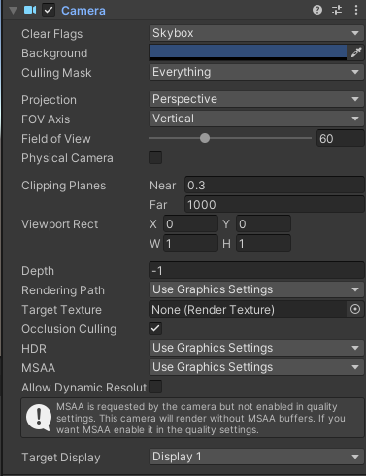

Slide 2
#version 330 core
layout (location = 0) in vec3 aPos;
layout(location = 1) in vec2 aTexCoord;
out vec2 TexCoord;
uniform mat4 projection;
void main() {
gl_Position = projection * vec4(aPos, 1.0);
TexCoord = aTexCoord;
}

Slide 3
public class Shader() {
[...]
public void setMatrix4(string name, Matrix4 matrix) {
GL.UniformMatrix4(GL.GetUniformLocation(this.program, name), false, ref matrix);
}
}

Slide 4
private void matrixProjection() {
Matrix4 projection = Matrix4.Identity;
projection *= CreatePerspectiveFieldOfView();
this.shader.setMatrix4("projection", projection);
}
Private Matrix4 CreatePerspectiveFieldOfView() {
float fovy = MathHelper.DegreesToRadians(60.0f);
float aspect = (float)this.width / (float)this.height;
float depthNear = 0.3f;
float depthFar = 1000.0f;
return Matrix4.CreatePerspectiveFieldOfView(fovy, aspect, depthNear, depthFar);
}

Slide 5
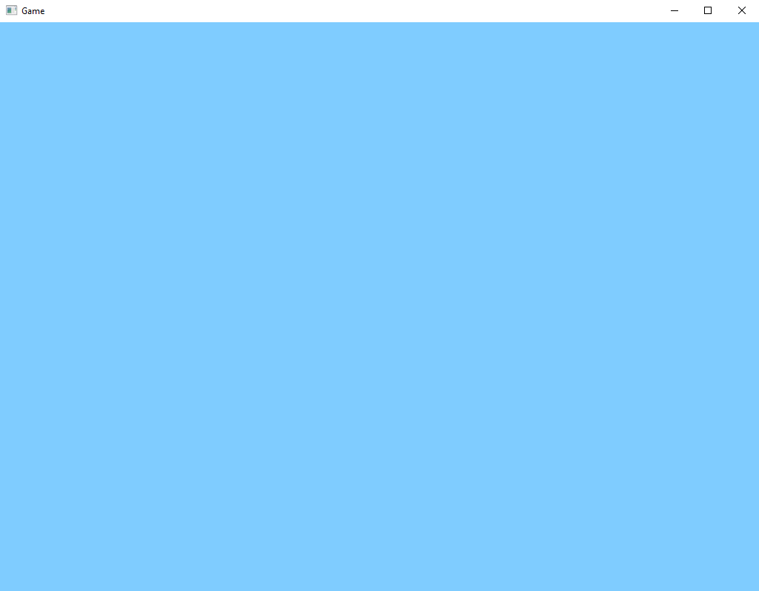

Slide 6
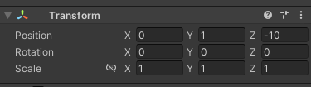

Slide 7
#version 330 core
layout (location = 0) in vec3 aPos;
layout(location = 1) in vec2 aTexCoord;
out vec2 TexCoord;
uniform mat4 projection;
uniform mat4 view;
void main() {
gl_Position = projection * view * vec4(aPos, 1.0);
TexCoord = aTexCoord;
}

Slide 8
private void matrixView() {
Matrix4 view = Matrix4.Identity;
view *= Matrix4.CreateTranslation(new Vector3(0.0f, 0.0f, -10.0f));
this.shader.setMatrix4("view", view);
}

Slide 9
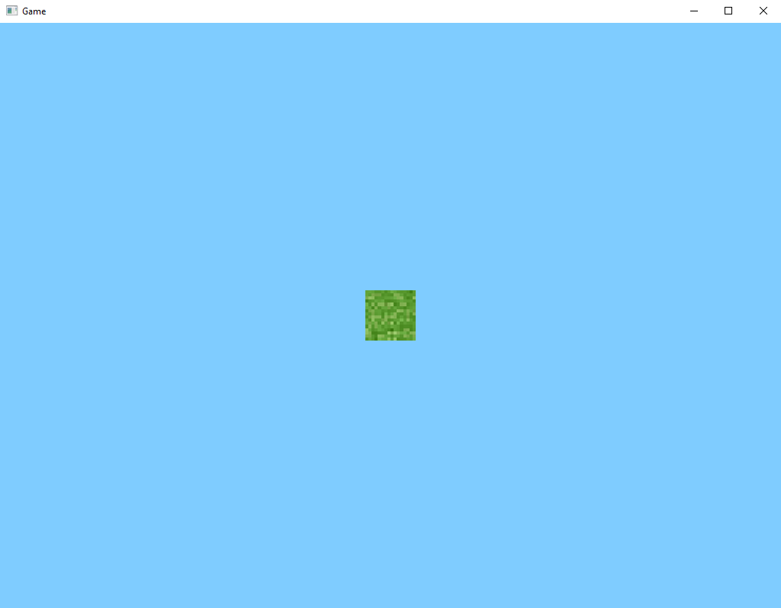

Slide 11
private void matrixProjection() {
Matrix4 projection = Matrix4.Identity;
projection *= CreatePerspectiveOffCenter();
this.shader.setMatrix4("projection", projection);
}
Private Matrix4 CreatePerspectiveOffCenter() {
float left = 0.0f;
float right = (float)this.width;
float bottom = 0.0f;
float top = (float)this.height;
float depthNear = 0.3f;
float depthFar = 1000.0f;
return Matrix4.CreatePerspectiveOffCenter(left, right, bottom, top, depthNear, depthFar);
}

Slide 12
?
?
?
?
?
?

Slide 14
private void matrixProjection() {
Matrix4 projection = Matrix4.Identity;
projection *= CreateOrthographic();
this.shader.setMatrix4("projection", projection);
}
Private Matrix4 CreateOrthographic() {
float width = (float)this.width;
float height = (float)this.height;
float depthNear = 0.3f;
float depthFar = 1000.0f;
return Matrix4.CreateOrthographic(width, height, depthNear, depthFar);
}

Slide 15


Slide 16
protected override void OnRenderFrame(FrameEventArgs args) {
[...]
//GL.ClearColor(0.5f, 0.8f, 1.0f, 0.0f);
[...]
}

Slide 17
#version 330 core
out vec4 FragColor;
uniform bool isWireframe;
in vec2 TexCoord;
uniform sampler2D texture0;
void main() {
if(isWireframe) {
FragColor = vec4(0.0f);
}
else {
//FragColor = texture(texture0, TexCoord);
FragColor = vec4(1.0f);
}
}

Slide 18
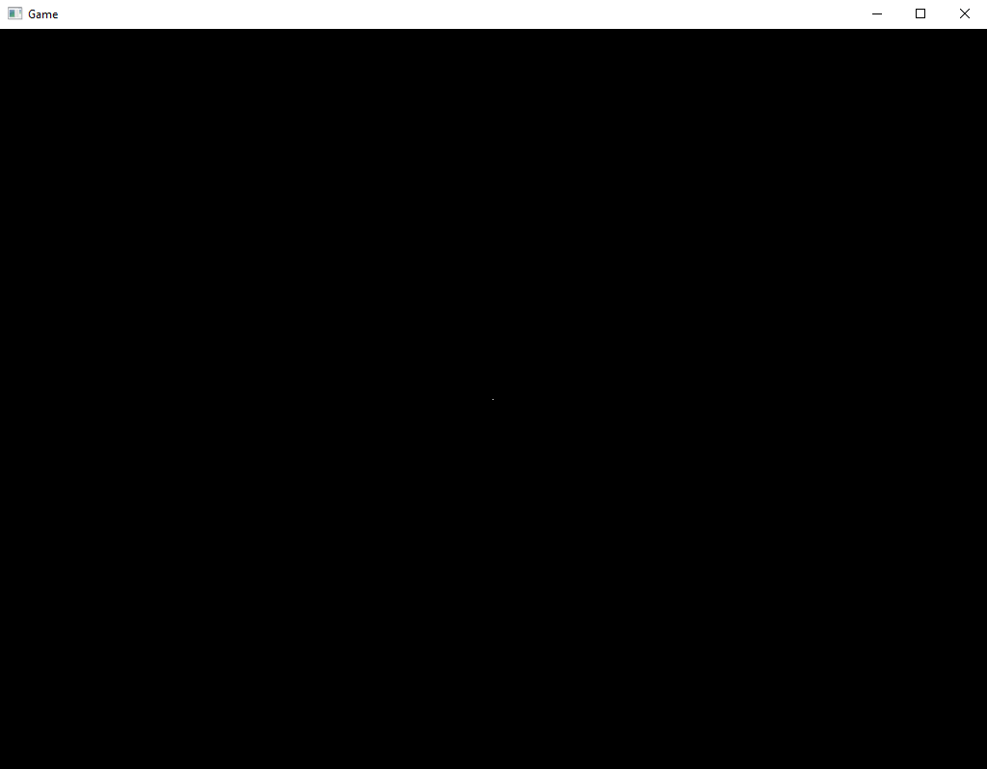

Slide 20
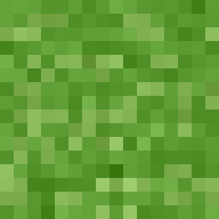
+Y
x0, y1
x1, y1
3
2
float x0 = -0.5f * 16.0f;
float y0 = -0.5f * 16.0f;
float x1 = 0.5f * 16.0f;
float y1 = 0.5f * 16.0f;
0
1
+X
x0, y0
x1, y0
x0, y0
x1, y0
x1, y1
x0, y1

Slide 21
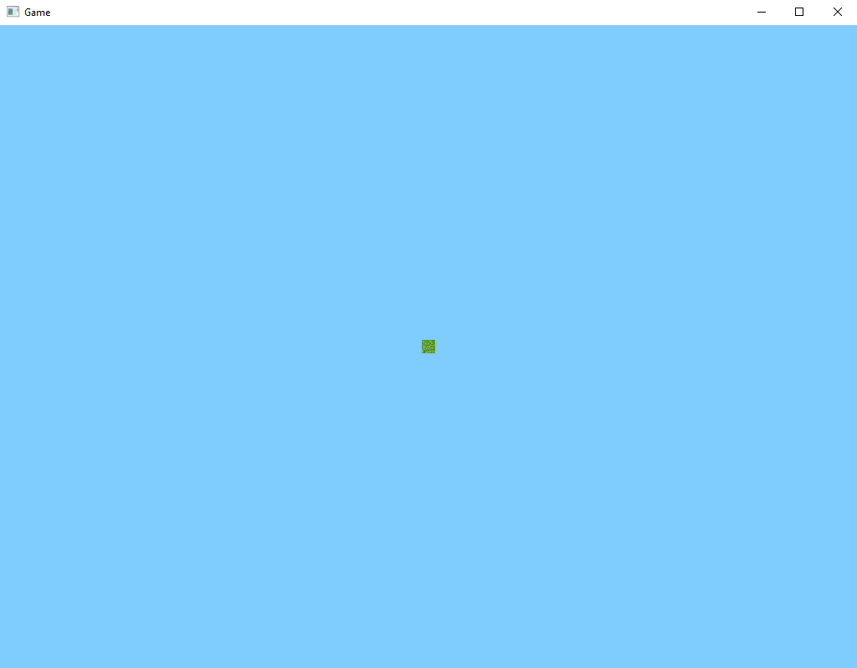

Slide 22
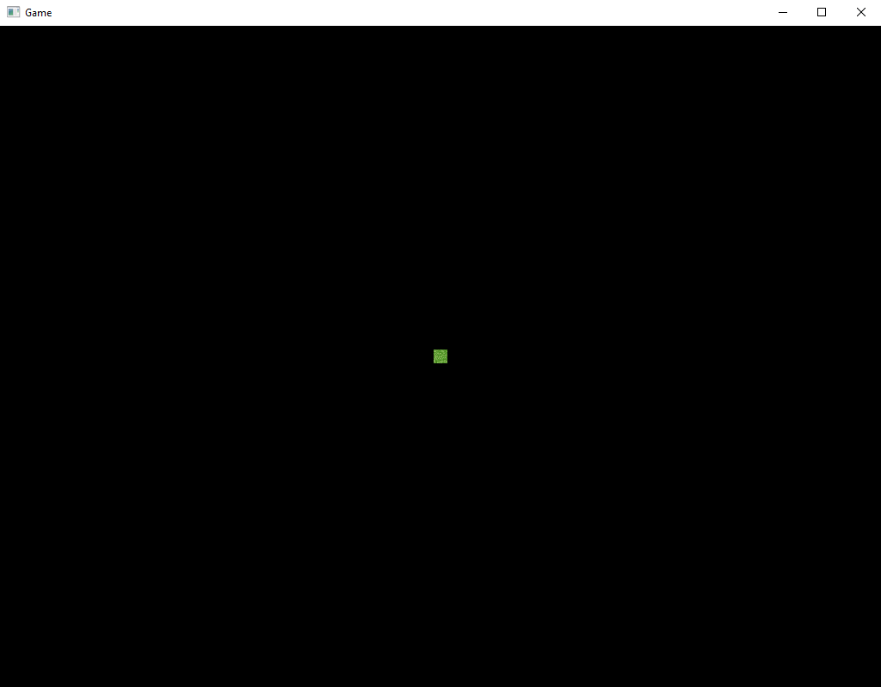

Slide 24
private void matrixProjection() {
Matrix4 projection = Matrix4.Identity;
projection *= CreateOrthographicOffCenter();
this.shader.setMatrix4("projection", projection);
}
Private Matrix4 CreateOrthographicOffCenter() {
float left = 0.0f;
float right = (float)this.width;
float bottom = 0.0f;
float top = (float)this.height;
float depthNear = 0.3f;
float depthFar = 1000.0f;
return Matrix4.CreateOrthographicOffCenter(left, right, bottom, top, depthNear, depthFar);
}

Slide 25
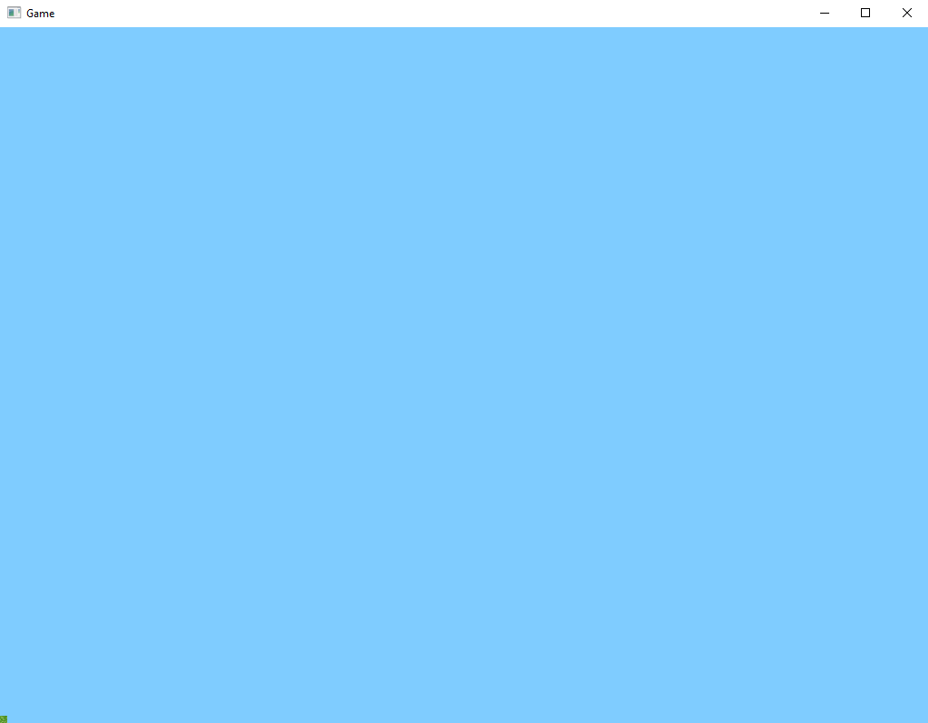

Slide 26
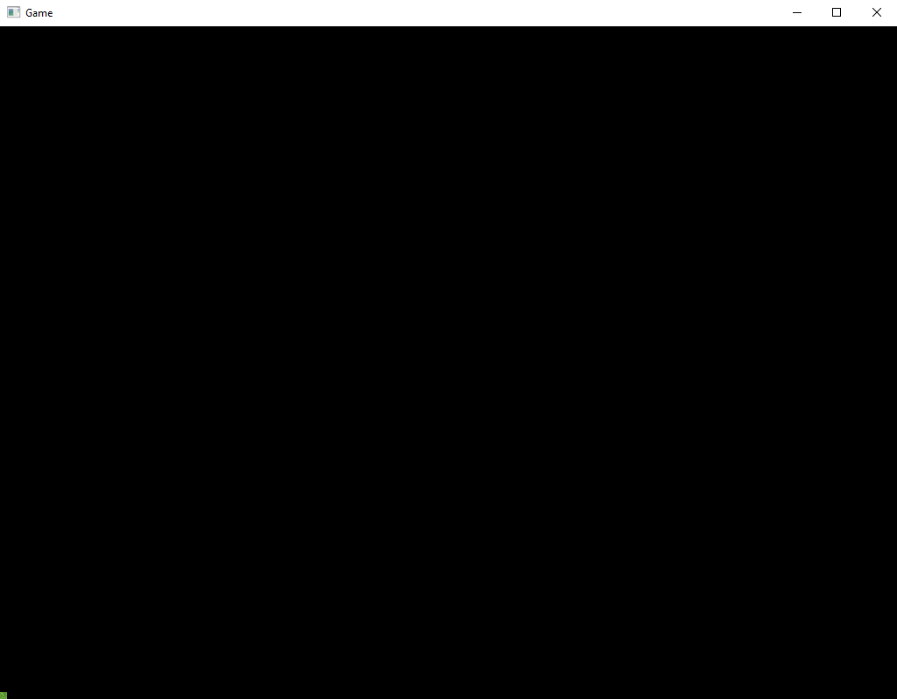

Slide 27
+Y
x0, y1
x1, y1
3
2
float x0 = 0.0f * 16.0f;
float y0 = 0.0f * 16.0f;
float x1 = 1.0f * 16.0f;
float y1 = 1.0f * 16.0f;
0
1
+X
x0, y0
x1, y0
x0, y0
x1, y0
x1, y1
x0, y1

Slide 28
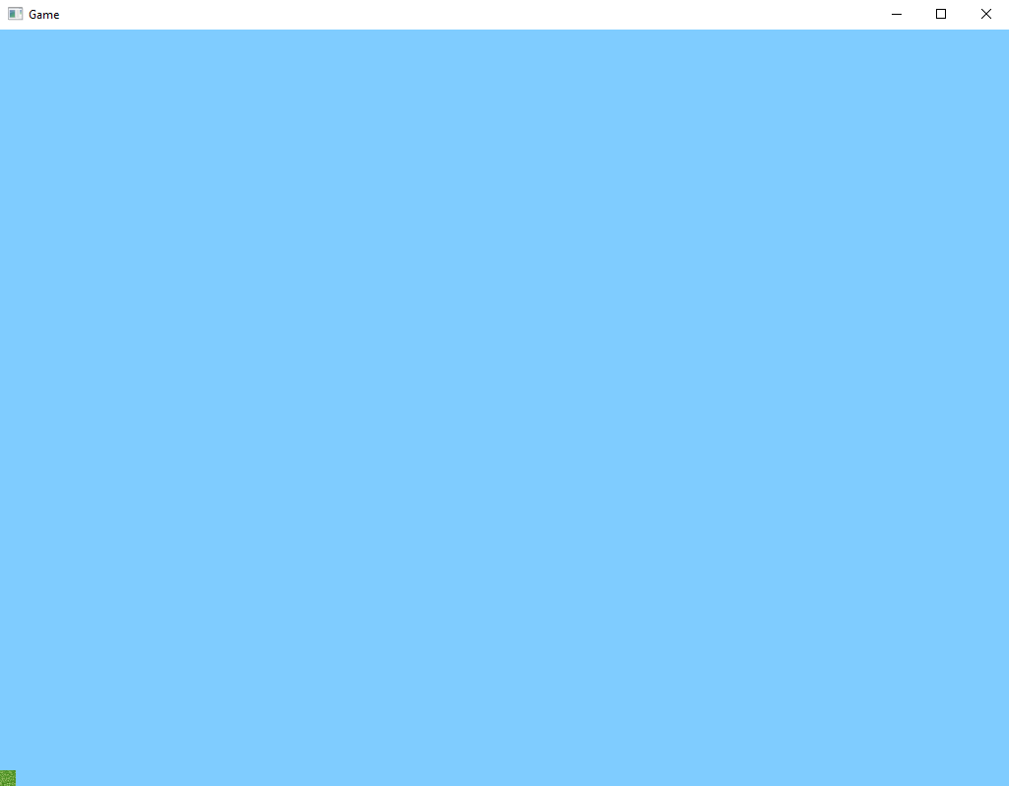

Slide 29
